Slide 1

SAP BTP ABAP on Cloud / RAP Training
DAY-20
Anubhav Oberoy
www.AnubhavTrainings.com
Follow excellence with sheer passion

Slide 2


DISCLAIMER
The training content and delivery of this presentation is confidential, and cannot be recorded, or copied and distributed to any third party, without the written consent of Anubhav Trainings

Slide 3

01
Attachment
02
Extensibility
03
Embedded Steampunk
04
Scenario
Notes:
https://pixabay.com/photos/san-francisco-transamerica-pyramid-1633203/

Slide 4
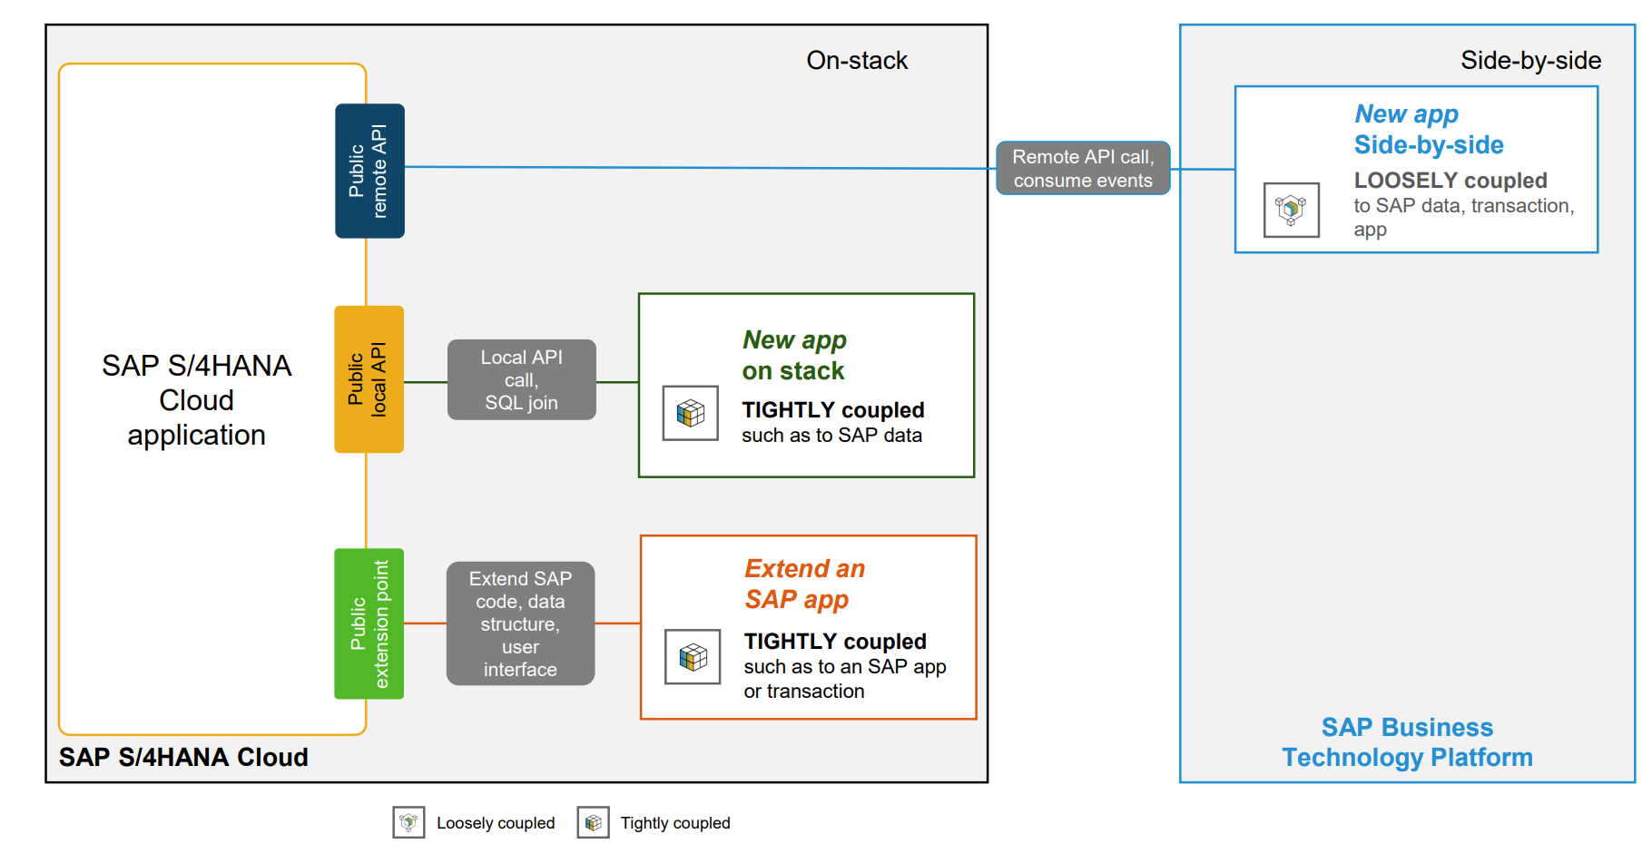
Extensibility Patterns
www.anubhavtrainings.com

Slide 5
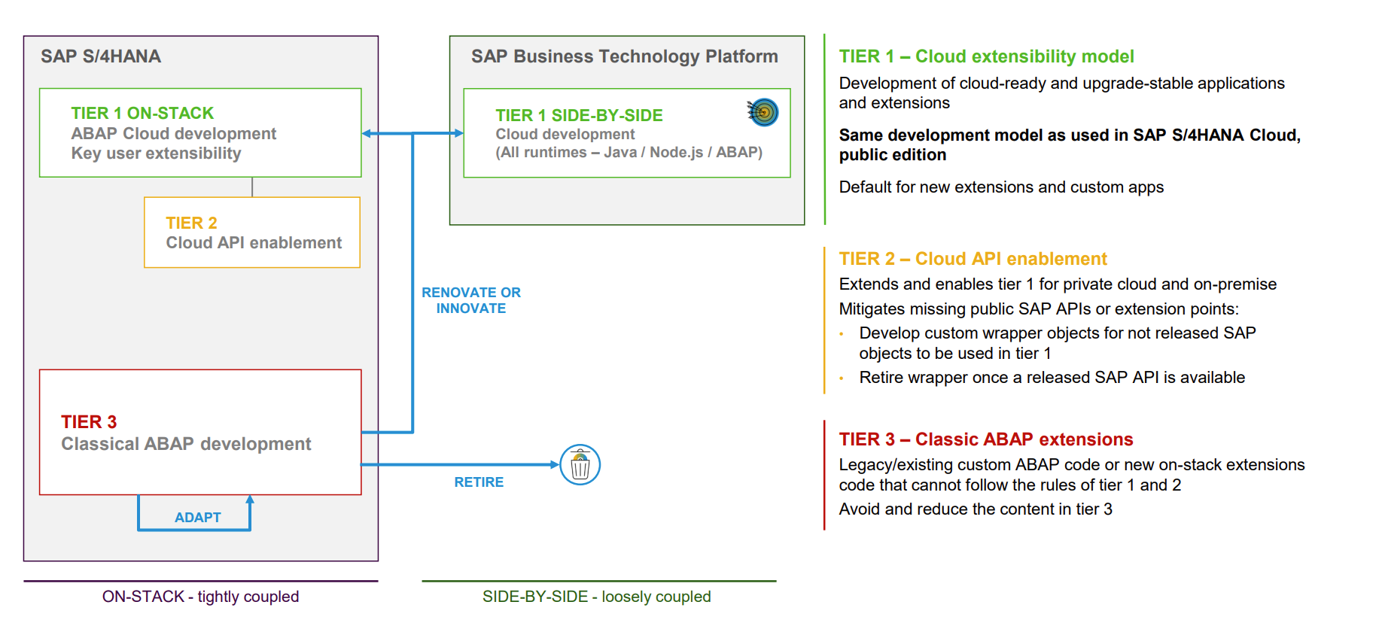
3-tier extensibility model for S/4HANA
www.anubhavtrainings.com

Slide 6
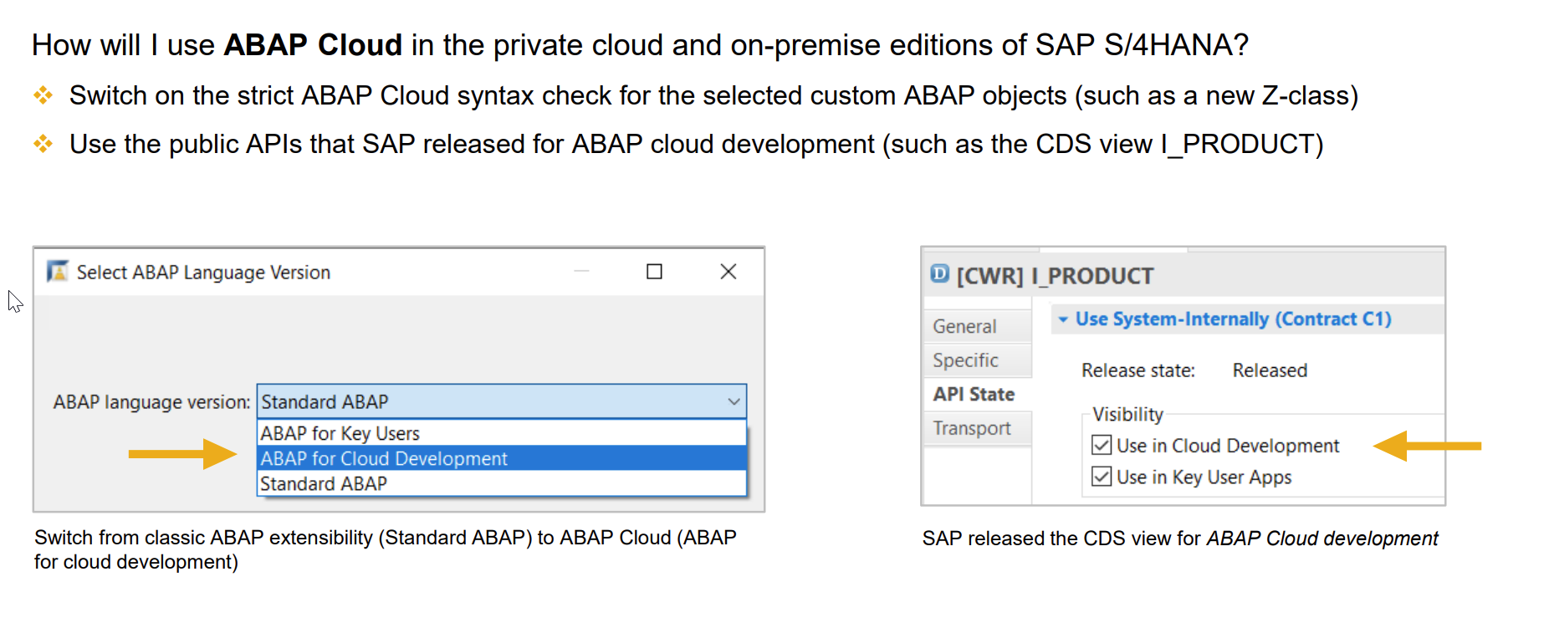
What is Embedded Steampunk
The term Embedded steampunk means running the ABAP on Cloud Environment within SAP S/4HANA enviornment
If we are using SAP BTP to develop side by side extensions, full stack SAP applications in BTP (Steampunk)
If we are using In-app Developer extensibility with released objects in S/4HANA (all editions) with RAP (Embedded Steampunk)
If you using RAP and enhancing your Standard SAP Applications delivered by SAP in S/4HANA system, the recommended approach is Embedded Steampunk.
Every Customer using S/4HANA can decide whether they want to use new approach (embedded Steampunk) or classic extension approach (BADI) @ Object level, This can be done by switching a setting @ object level.
www.anubhavtrainings.com

Slide 7
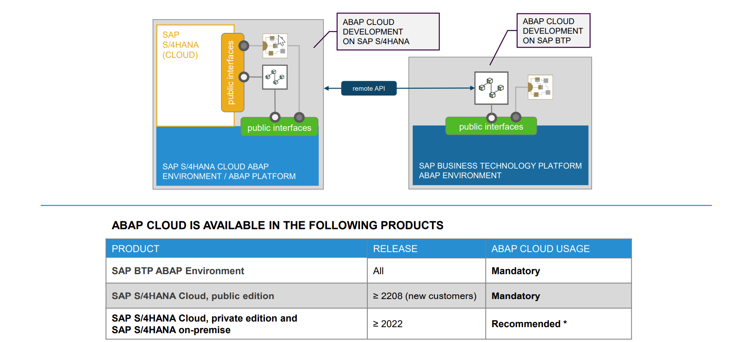
Availability – ABAP on Cloud - Steampunk
www.anubhavtrainings.com

Slide 8

Demo
www.anubhavtrainings.com

Slide 9
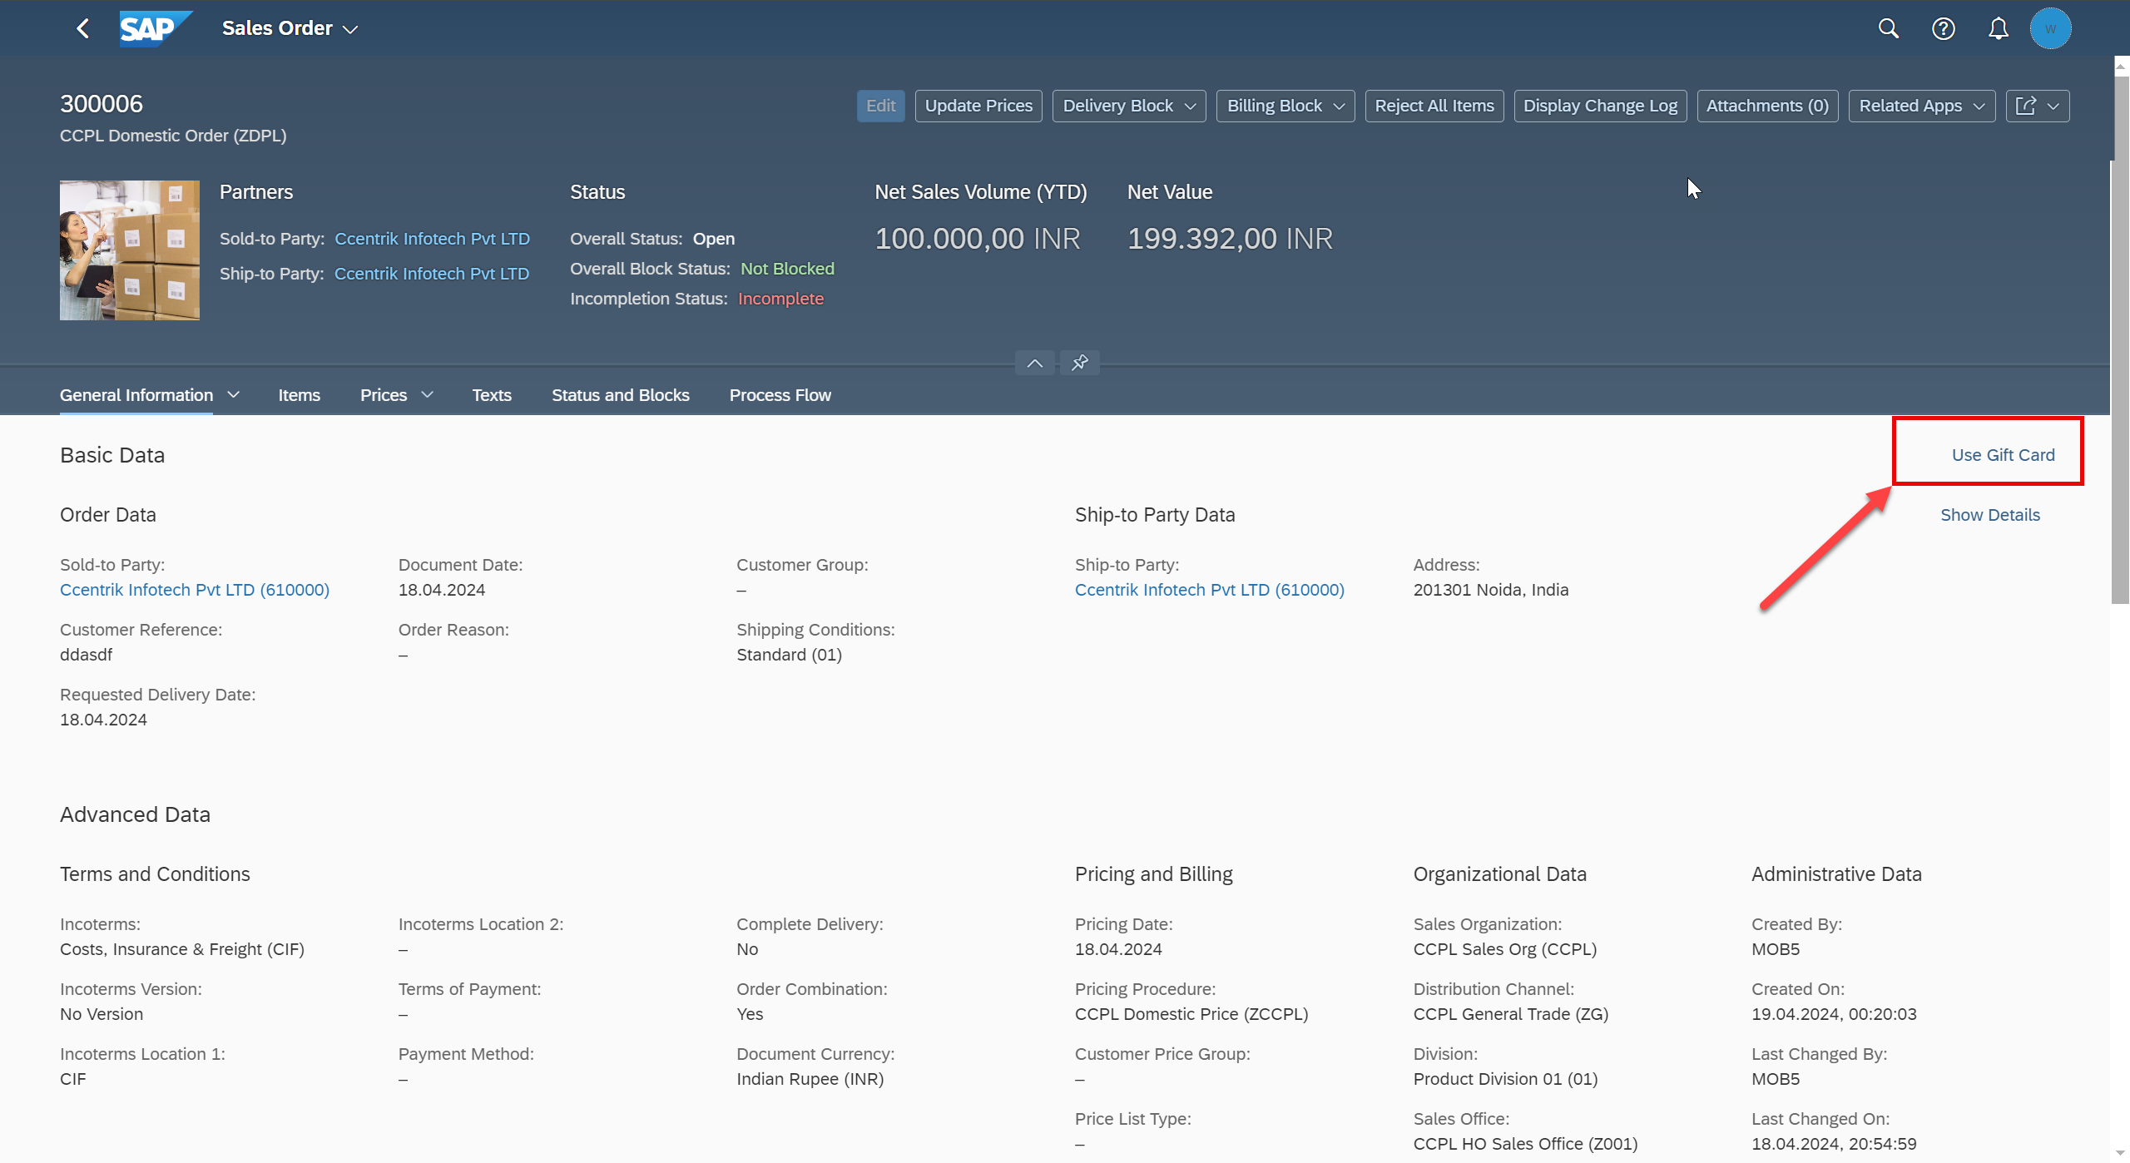
Scenario
www.anubhavtrainings.com

Slide 10
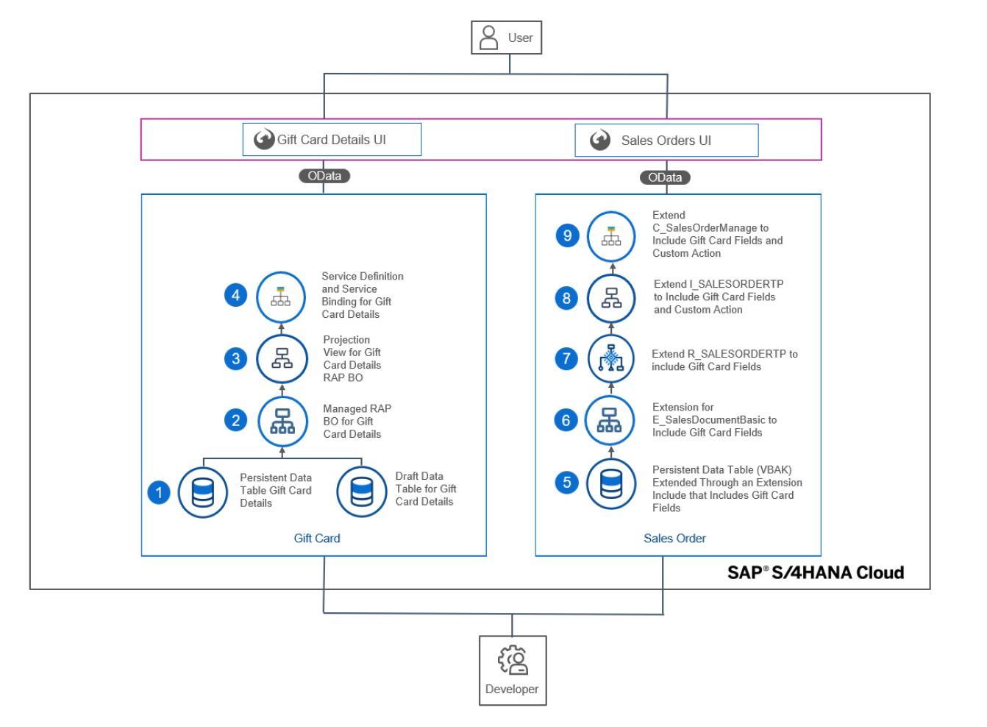
Development Objects
www.anubhavtrainings.com

Slide 11





















Slide 12

Finding RAP extension objects in ADT and HUB
As a developer in our company how can we ensure or find the released SAP object (CDS views, APIs, RAP business object) so when a requirement comes to me for enhancing standard Fiori Apps or functionality in S/4HANA, I can use the embedded Steampunk for developer extensibility.
Directly using ADT – appl:sd api:extend_in_cloud_development
Refer the documentation on https://api.sap.com
Example of Sales order
SAP Standard Fiori App
I_SalesOrderTP
C_SalesOrderManage
R_SalesOrderTP
www.anubhavtrainings.com

Slide 13
Activate standard app
We need to find the sales order application in SAP Fiori App reference library
We need to check its configuration
Activate the Standard Fiori App using Rapid Fiori Activation Task list and generate the role
Will activate all the odata services, and configure catalog and group with the role so that our user can access the Fiori apps.
Tcode: STC01
Tasklist: SAP_FIORI_CONTENT_ACTIVATION
Role: SAP_BR_INTERNAL_SALES_REP
Go to PFCG and assign the role ZSAP_BR_INTERNAL_SALES_REP
Assign the role to our user to access this Fiori app
Make sure that in SPRO all the pricing conditions, pricing procedure and mapping of Sales org with procedure in tcode OVKK is maintained – Functional consultant
Test Data: if you are using Anubhav training system to demo this scenario use below test data:
Order Type: ZDPL
Sales Organization: CCPL
Distribution Channel: ZG
Division: 01
Ship to Party: 610000
Material: 167
Testing – Create sales order - /n/ui2/flp
server@anubhavtrainings.com
Subscribe an S/4HANA 2023 OP system access @ 40 USD per month
www.anubhavtrainings.com

Slide 14
Certification
https://training.sap.com/certification/validity?keepQueryParams=1&keepRequestMethod=1
https://training.sap.com/certification/c_abapd_2309-sap-certified-associate--back-end-developer---abap-cloud-g/?
C_ABAPD_2309
SAP Certified Associate – Back-End Developer - ABAP Cloud
Raj.shettyhyd@gmail.com
DYOR
Anubhav.abap@gmail.com
www.anubhavtrainings.com

Slide 15
Certification
https://training.sap.com/certification/validity?keepQueryParams=1&keepRequestMethod=1
https://training.sap.com/certification/c_abapd_2309-sap-certified-associate--back-end-developer---abap-cloud-g/?
C_ABAPD_2309
SAP Certified Associate – Back-End Developer - ABAP Cloud
Raj.shettyhyd@gmail.com
DYOR
Anubhav.abap@gmail.com
www.anubhavtrainings.com

Slide 16
www.anubhavtrainings.com
Thank You
End of Day 20
www.anubhavtrainings.com

Slide 17


We’re committed to empower you to be
#FutureReady
through powerful training solutions.
We build the workforce of the future.
250+
Corporate Clients
30,000+
Learners Trained
25000+
Learners Placed
FREE WEBINARS
Sign up for free webinars with industry experts every fortnight!
Enroll Now!
Contact us today!
https://anubhavtrainings.com

